Slide 1
The VVV Reunion July 15 – 19, 2015
Newport News, Virginia

Slide 2
This year the VVV Reunion started a day early, with a private tour of the United States Capitol building. This special treat was arranged by Senator Roger Wicker.

Slide 3
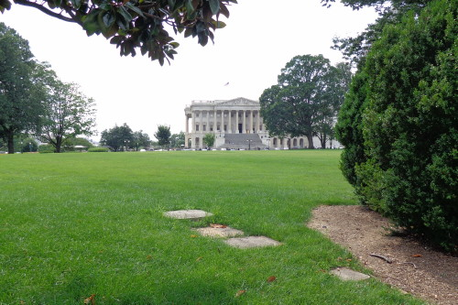

Slide 4
Getting there was part of the fun. Many of us rode the Metro. Here, the Beasley family is on their way.

Slide 5
We gathered in front of the Statue of Freedom before starting the tour.

Slide 6
The library of Congress is across the street from the Capitol building.

Slide 8
VVV President, Bruce Vawter opened the reunion .

Slide 9
Kaylee Wyatt and Lilah Vawter helped ring the traditional cowbell to open the reunion.

Slide 10
Reba Alexander led the pledge of allegiance.

Slide 11
Some of the missing memorabilia has been located.

Slide 12
After the business meeting, the cousins enjoyed the genealogy session by Georgene.

Slide 13
The living museum was one of the attractions visited by some of the Vawter cousins.

Slide 14
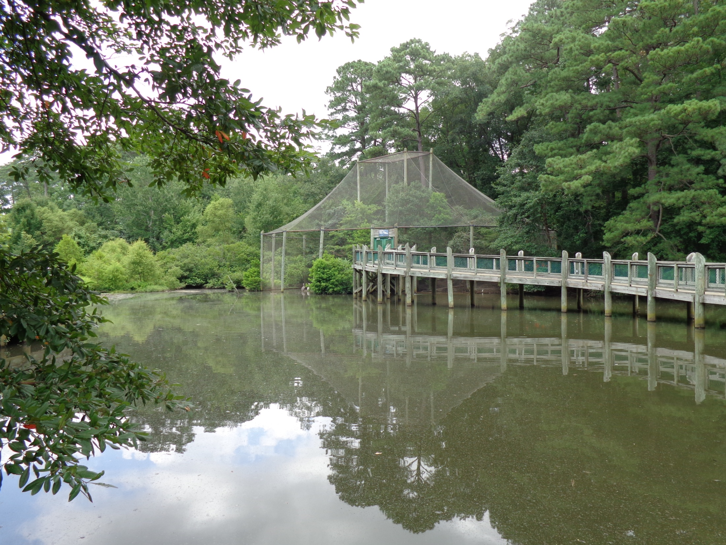

Slide 15
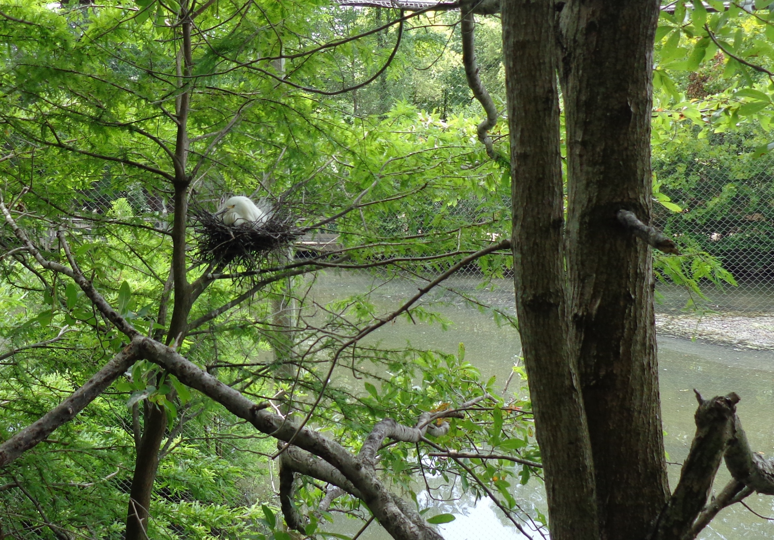

Slide 16
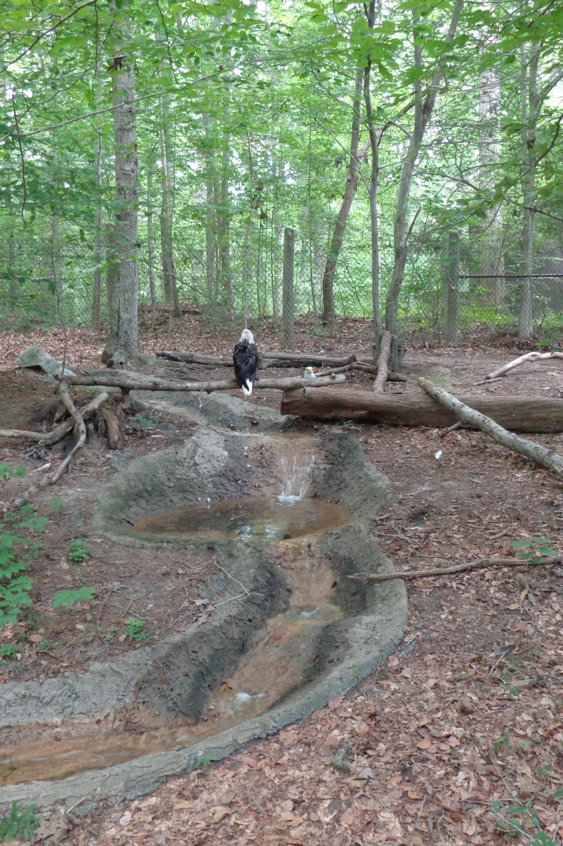
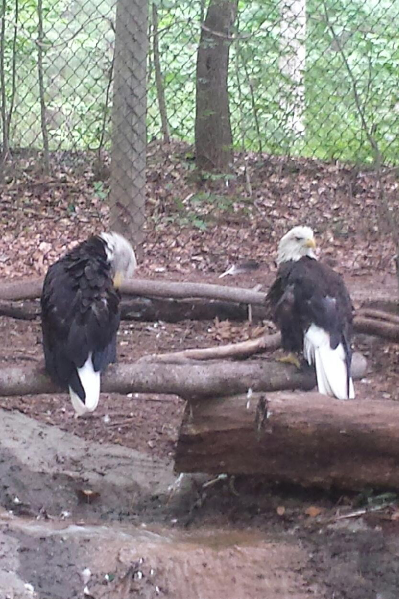

Slide 17
Saturday the cousins journeyed to the Vauter’s Episcopal Church. ( Many returned Sunday for services.)

Slide 18
The Glebe, which was the pastor’s residence many years ago, is in the process of being restored.

Slide 19
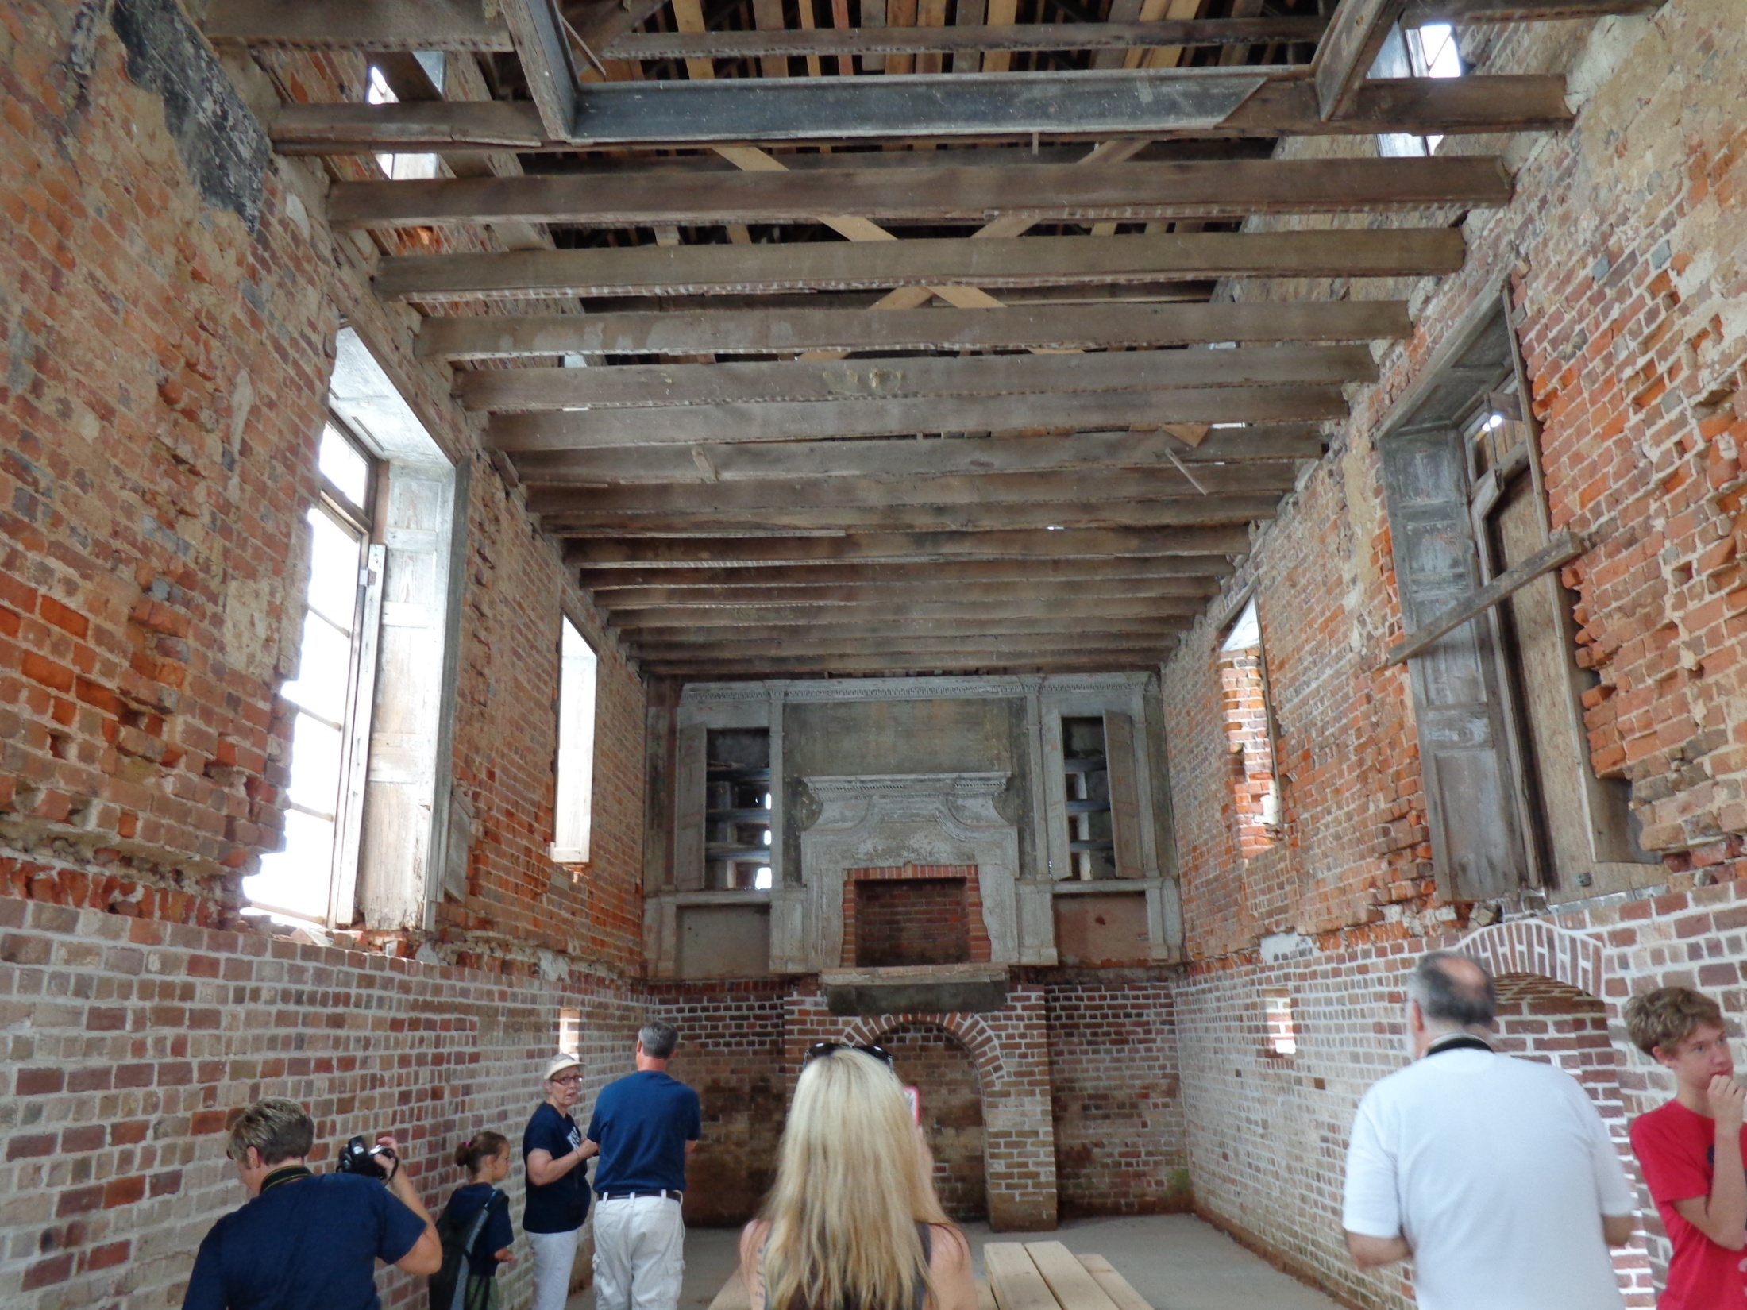

Slide 20
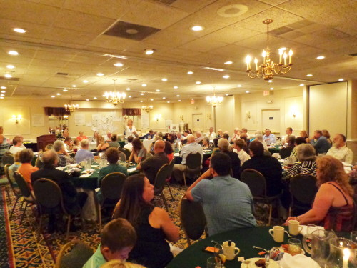
The banquet.

Slide 21
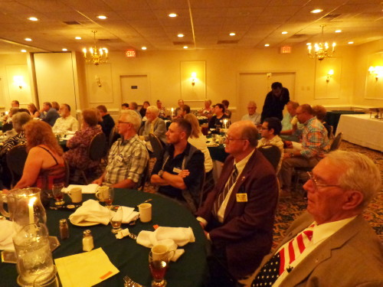

Slide 22
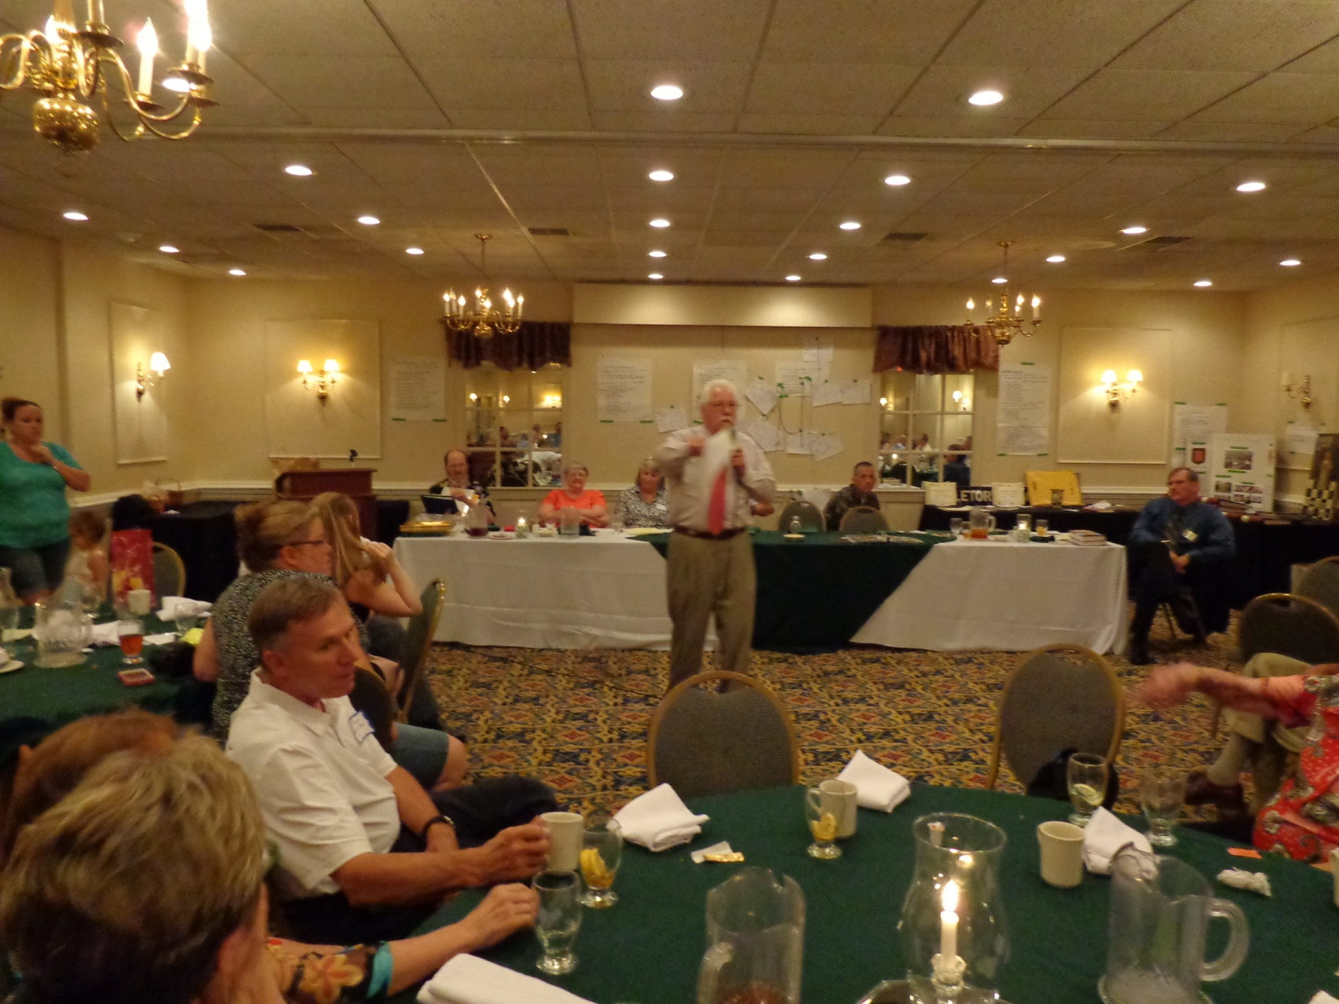
The auction to benefit the Vauter’s Church.

Slide 23
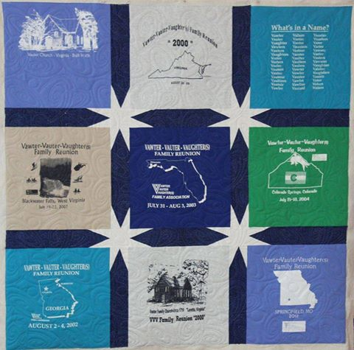
Many items were donated for the auction, including this beautiful quilt made by Georgene.

Slide 24
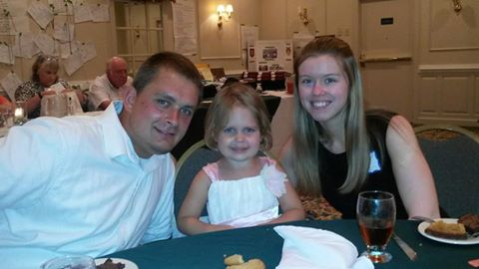
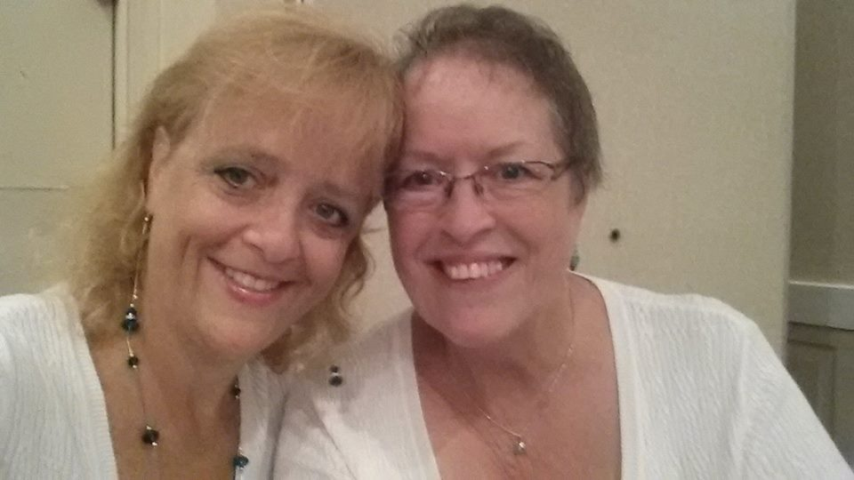
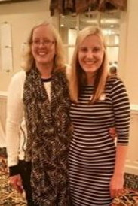
Just visiting.

Slide 25
The “Kansas” group of cousins. front row: Mary Vawter Burgett ~ Brynna Perry 2nd row: Nancy Vawter Southard ~ Lois Vawter Shuck ~ and in the green/Marjory Shaffer ~ Doris Knutson ~ Sheri Collie ~ Wilma Hood 3rd row & back row sort of zig-zag: Mike McNary ~ Matt McNary ~ Jennifer McNary back row: Greg Burgett ~ (peaking through) Jodi Perry ~ back row/Tim Nedeau ~ Mary Wilhelm ~ Chuck Wilhelm ~ Karyn Collie ~ back row/Wayne McNary ~ Tom Hood

Slide 26
The Wicker family

Slide 27
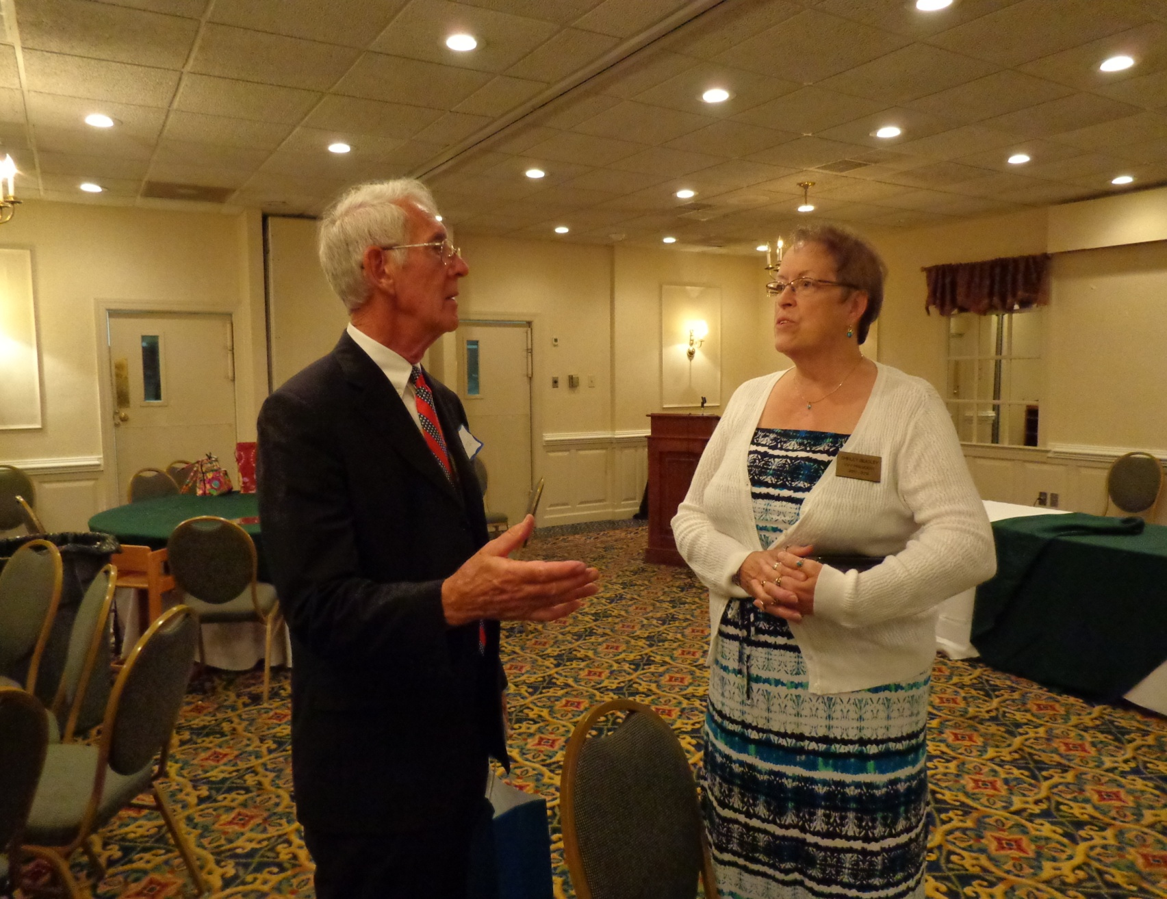
Jim Vaughters and Shirley Beasley. Good to see Jim after many years.

Slide 28
Once again, we had a wonderful reunion.
A big “thank you” to Ellen Cummings and Roger Wicker.
Hope to see you all next year in Arkansas. Chad Bugos will host.
Thanks to all who shared their pictures. For many more pictures,
see the postings on Facebook.

